Slide 1
Irregular Verbs
Rap

Slide 2




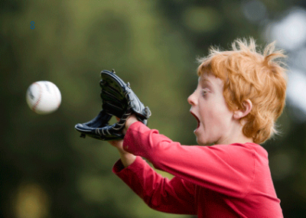

Irregular verbs are easy for me
Listen to the song and you will see
See - Saw - Seen
Be - Was - Been
Think - Thought - Thought
Buy - Bought - Bought
Always remember Catch - Caught - Caught
And one for the teacher Teach - Taught - Taught

Slide 3



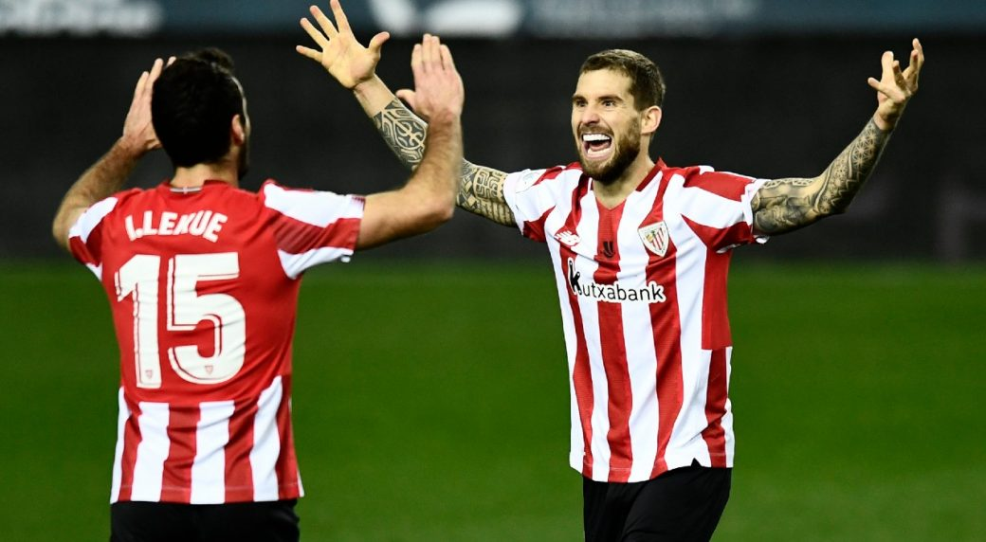
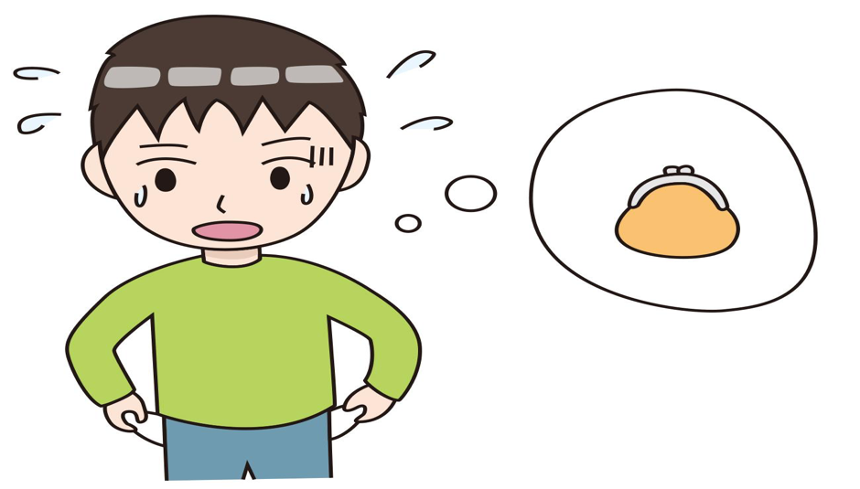

Come - Came - Come and
Do - Did - Done
Swim - Swam - Swum and
Win - Won - Won
Everybody look around
Lose - Lost - Lost and
Find - Found - Found

Slide 4
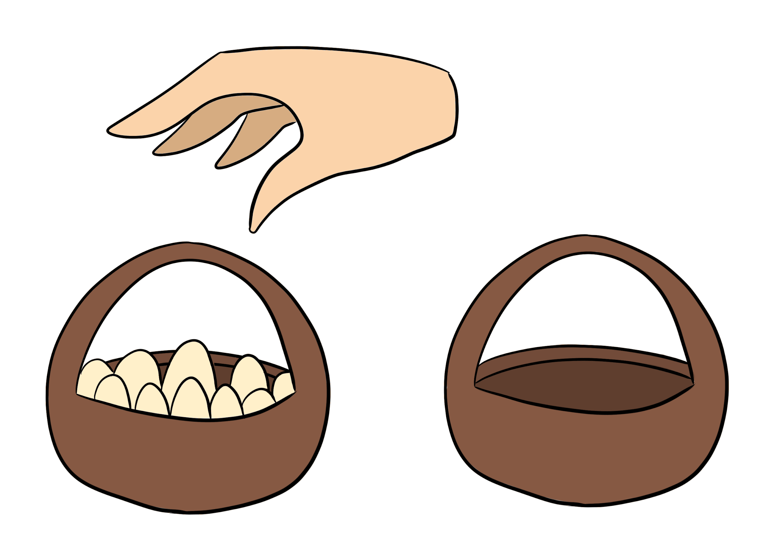
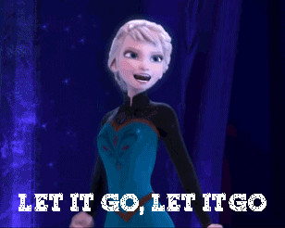
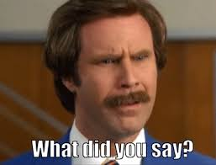

Some don’t change so don’t forget
Put - Put - Put and
Let - Let - Let
Always keep it in your head:
Say - Said - Said and
Read - Read - Read

Slide 5

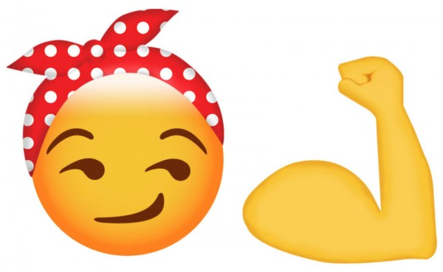

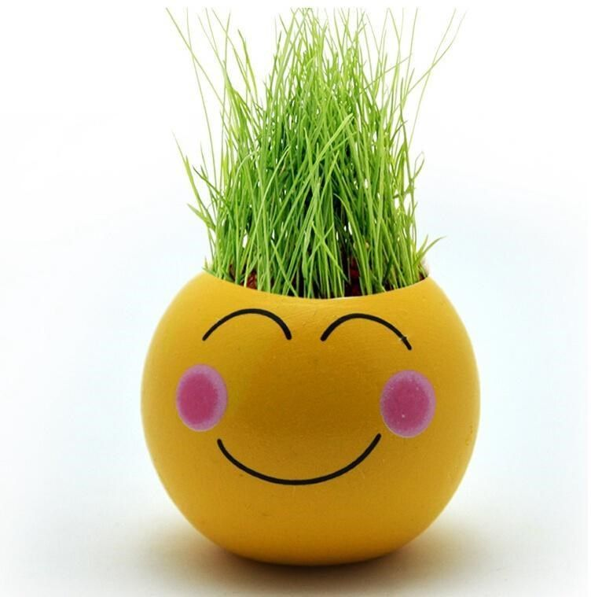
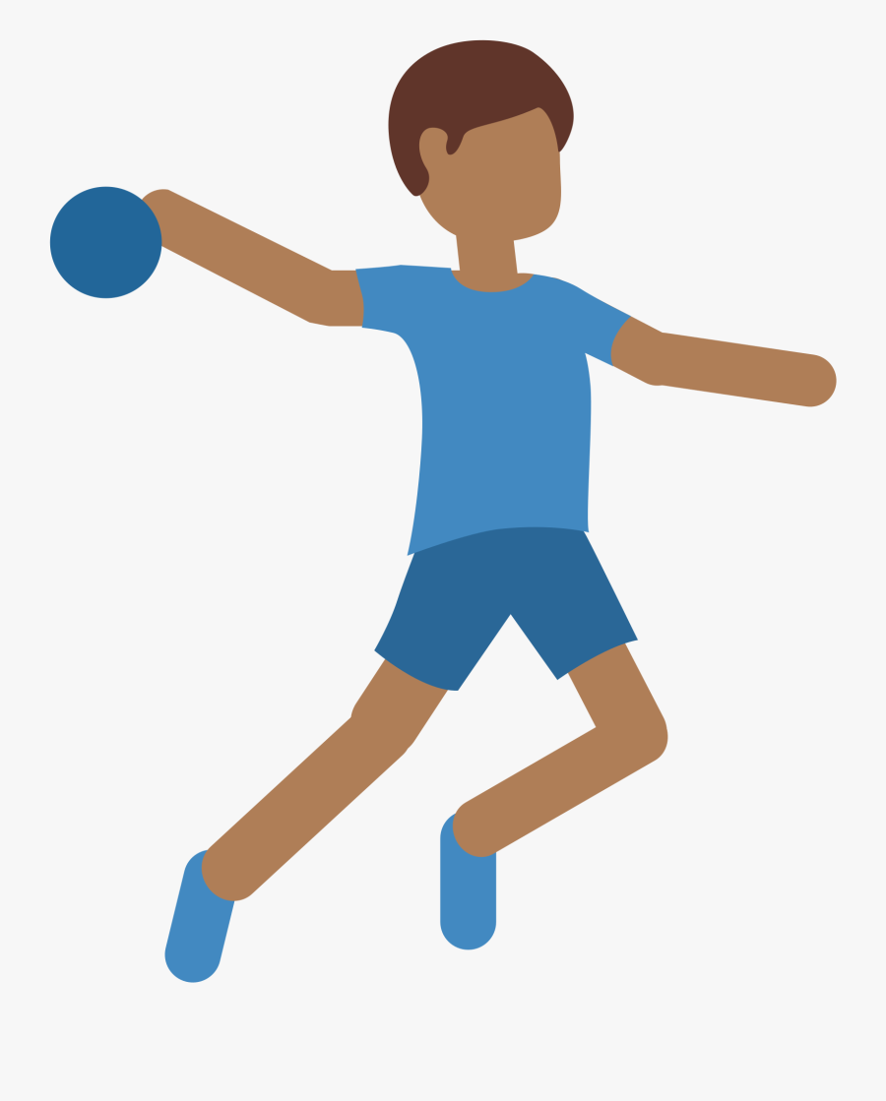

Some are different, don’t be afraid of
Hear, heard, heard and
Make, made, made
Know, knew, known and
Grow, grew, grown
Throw, threw, thrown and
Fly, flew, flown

Slide 6
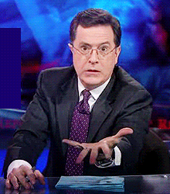
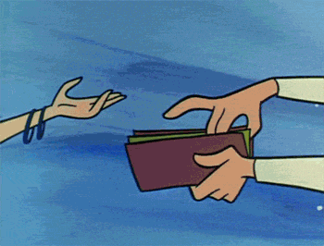

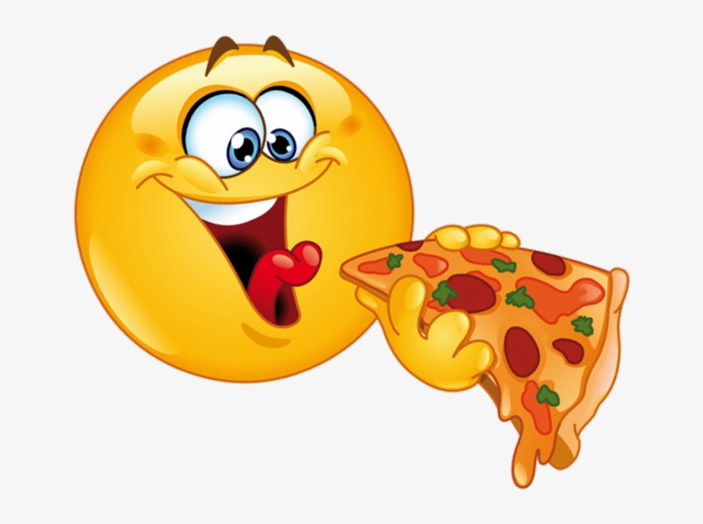
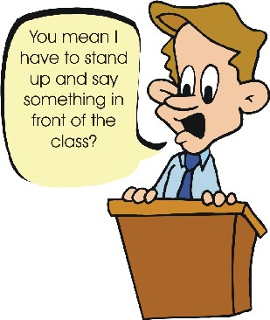

Some verbs end in “e” and “n” like:
Give, Gave, Given
Take, Took, Taken
Write, Wrote, Written
Eat, Ate, Eaten
Speak, Spoke, Spoken and
Break, Broke, Broken

Slide 7


Is it good or is it bad?
30 verbs we Have, Had, Had
Now this is the end of our song
So Go, Went, Gone in …. 3,2,1!

Slide 8
Positive (to be)
I am/ I was
Negative (to be)
I am not/ I was not
Am I/ Was I/ Were you …?
Question (to be)

Slide 9
To be: question. Was I… / Were you…?

Slide 10
To be: positive answer. I was…

Slide 11
To be: negative answer. I wasn’t …

Slide 12
 | Present Simple |  |  | Past Simple
 | Question | Positive | Negative | Question | Positive | Negative
 | Do you see? | I see | I don’t see | Did you see? | I saw | I didn’t see
 | Are you? | (Be) I am | I am not | Were you ? | I was | I was not
 | Do you think? | I think | I don’t think | Did you think? | I thought | I didn’t think
 | Do you buy? | I buy | I don’t buy | Did you buy? | I bought | I didn’t buy
 | Do you catch? | I catch | I don’t catch | Did you catch? | I caught | I didn’t catch
 | Do you teach? | I teach | I don’t teach | Did you teach? | I taught | I didn’t teach
 | Do you come? | I come | I don’t come | Did you come? | I came | I didn’t come
 | Do you do? | I do | I don’t do | Did you do? | I did | I didn’t do
 | Do you swim? | I swim | I don’t swim | Did you swim? | I swam | I didn’t swim
 | Do you win? | I win | I don’t win | Did you win? | I won | I didn’t win

Slide 13
The verb “to be” - Past Simple
Question | Positive | Negative
Was I …? | I was | I wasn’t
Were you? | You were | You were not
Was he..? | He was | He was not
Was she..? | She was | She was not
Was it..? | It was | It was not
Were we..? | We were | We were not
Were they? | They were | They were not

Slide 14
Eric | Yesterday I put the eggs in the fridge. | Last week my mum let me go to the park. | Last month my neighbour said that he was going to kill me. | This morning I read a some of my book.
Izaro | This morning I put my tablet in my schoolbag. | “Let it go” sang Elsa. | Yesterday my mum said that she would let me have a surprise. | This morning I read a mystery book.
Jokin | Yesterday I put the watermelon in the fridge. | This morning my dad let me go to a party. | Earlier I said that I was a person. | Yesterday I read a book.
Jagoba | I put my tablet in my schoolbag this morning. | My teacher let me play with her car. | The teacher said the opposite of me in class last week. | Last week I read a book called “Blue Lock”.
Alba | This morning I put my ipad in my schoolbag | My teacher let us play games in class. | Last week my mum said that I was great! | Yesterday I read a book.
June | I put the eggs in the frying pan. | My brother let me massage him. | Yesterday, I said that I would bake a cake. | Yesterday I read a comic.

Slide 15
 | Question | Positive | Negative
Eric
Izaro
Jokin
Jagoba
Alba
June

Slide 16
 | Question | Positive | Negative
Eric
Izaro
Jokin
Jogoba
Alba
June

Slide 17
 | Question | Positive | Negative
Eric
Izaro
Jokin
Jogoba
Alba
June

Slide 18
Were they at the football match last weekend? | Yes, they were. They were at the football match last weekend. They were very sad when Athletic Bilbao lost the match. | No, they weren’t. They weren’t at the football match last weekend. They were at the park.
Was she happy last week? | Yes, she was. She was happy last week because she got some great presents for Christmas. | No, she wasn’t. She wasn’t happy because she was confined for the Christmas holidays.
Were you at the swimming pool last week? | Yes, I was. I was at the swimming pool last week. We had a great time! | No, I wasn’t. I wasn’t at the swimming pool last week because my mum said that it was too dangerous to go with covid.
Was he eating at Burger King yesterday? | Yes, he was. He was eating at Burger King yesterday. He loves Burger King. | No, he wasn’t. He wasn’t eating at Burger King yesterday. He hates Burger King.

Slide 19
Ane | Did you come to gymnastics class last Tuesday? | Yes I did. I came to gymnastics class last Tuesday. | No I didn’t. I didn’t come to gymnastics class last Tuesday.
Aroa | Did you catch the ball last Monday? | Yes I did I caught the ball last Monday | No I didn’t. I didn’t catch the ball last Monday.
Lier | Did Bilbao Athletic win their last match against Real Madrid? | Yes they did. They won their last match against Real Madrid. | No they didn’t. They didn’t win their last match against Real Madrid.
Alejo | Did you lose anything last Monday? | Yes I did, I lost a ball last Monday. | No I didn’t, I didn’t lose anything last Monday.

Slide 20
Beñat | Joel, did you teach English last week? | Yes, I did. I thought English last week. | No I didn't. I didn’t teach English last week.
Dustan | Did you think about playing football last Monday. | Yes I did. I thought about playing football last Monday. | No,I didn’t,I didn’t think about football last monday
Alejo | Did you find a pencil yesterday? | Yes I did, I found a pencil yesterday. | No I didn’t , I didn’t find a pencil yesterday.

Slide 24
Did you make dessert?
I made a cake. (bake with types of bread.) I made dessert.
I didn’t make dessert.
Did he eat pizza?
He ate pizza. It was delicious… mmmm… pizza…
He didn’t eat pizza… booo….
Did you come from Bilbao?
We came from Bilbao.
We didn’t come from Bilbao.
Lucas

Slide 25
Lucas

Slide 26
I ate pizza earlier today.
I didn’t throw the ball outside today.
Did you speak English yesterday?
She came from Australia last week.
He didn’t make an omelette last night.
He didn’t bake a cake last week .
Were you at home when the phone rang at eight o’clock?
She bought new shoes yesterday.
We can’t fly.
Did you hear me just a minute ago?
June

Slide 27
I knew that person was sad last year, but now he’s really happy because he’s in Barry’s class! Yay!! ;o)
We didn’t give him the present yesterday.
Did I break her pencil today?
I threw the ball outside last Wednesday.
They didn’t read books on Fridays.
Did she find her pencil last night.
You came from Murgia last night.
I didn’t swim in the sea today.
Did you hear what I said a minute ago.
June

Slide 28
Will she be happy if she finds her pencil?
Yes, Martha will be happy if she finds her pencil. She loves her pencil, she calls it Penci.
Will I buy ice cream?
Yes, I will!!!!!
No, I won’t buy any ice cream… :o(
Are you going to clean your room?
No, I am not going to clean my room!
Yes, of course, I’m going to clean my room.
June

Slide 29
Is she going to watch tv?
Yes, she’s going to rot her brain and watch tv.
Are we going to go swimming?
Yes, we are going to go swimming.
June

Slide 30
Did I do my homework?
I did my homework.
I didn’t do my homework.
Did I go to Madrid?
I went to Madrid.
I didn’t go to Madrid.
Did I catch the ball?
I caught the ball.
I didn’t catch the ball.
Ander O

Slide 31
Did I hear my alarm clock this morning?
Yes, I heard my alarm clock this morning.
No, I didn’t hear my alarm clock this morning, I’m late!!
Did you eat pizza yesterday?
Yes, I ate pizza yesterday, it was delicious!
No, I didn’t, we had chicken and chips.
Did you find your keys?
Yes, I found my keys.
No I didn’t find my keys. I had to call a locksmith.
Ander O

Slide 32
Did I put my notebook in my folder?
I put my notebook in my folder.
I didn’t put my notebook in my folder.
Did I do karate?
I did karate.
I didn’t do karate.
Did you eat pizza?
You ate pizza.
You didn’t eat pizza.
Ander B

Slide 33
Did I do my homework?
Yes, I did my homework last Sunday.
No, I didn’t do my homework.
Did you buy a bike?
Yes, I bought a bike.
No, I didn’t buy a bike.
When did you come to Bilbao?
I came to Bilbao last Friday.
I didn’t come to Bilbao, I’m in Donostia.
Ander B

Slide 34
Did I make a model of a beach?
I made a model of a beach.
I didn’t make a square model.
Jon

Slide 35
Did you buy a skateboard?
Yes I did. I bought a skateboard.
I didn’t buy a video game.
Did you write an adventure book?
Yes, I did. I wrote an adventure book.
No, I didn’t. I wrote a fantasy book.
Did you speak in Spanish?
I spoke in Spanish.
I didn’t speak in Catalan.
Jon

Slide 36
Did I go to the square?
No, I didn’t. I went to the beach
I didn’t go to the square.
Did I eat pizza?
I ate pizza.
I didn’t eat salad.
Did I know the answer?
I knew the answer.
I didn’t know the answer.
Oier

Slide 37
When did you come here?
I ate pizza last Friday.
I didn’t put the folder in my bag last night.
I did my homework last Saturday.
Where did you see that man?
I knew all the answers in the exam.
I didn’t read that book last month.
When did you go to Madrid?
I didn’t throw the ball last Monday.
Oier

Slide 38
Oier

Slide 39
Did you play football?
I didn’t play football.
I played football.
Did you like the cat?
I didn’t like the cat.
I liked the cat.
Did you dance at the weekend?
I didn’t dance at the weekend.
I danced at the weekend.
Daniel

Slide 40
Did you make an omelette?
Did you bake a cake?
I made an omelette. I baked a cake.
He didn’t make an omelette. He didn’t bake a cake.
Did you grow last year?
I grew 6cm last year.
I didn’t grow last year.
Did you read a book last month?
I read a book last month.
I didn’t read a book last month.
Daniel

Slide 41
I did my homework.
I made an omelette.
I played with my lego.
I baked a cake.
I did not go to the cinema.
I did not go to the garden.
We did not read a book.
Did she play basketball?
Did he sing?
Did he swim?
Sara

Slide 42
Will Jon do his homework for next week?
Yes, he will. He will do his homework.
Will she buy the new Harry Potter book?
No, she will not buy the new Harry Potter book.
No, she won’t.
Will we go to the cinema next week?
Yes we will go to the cinema next week.
Are you going to visit Disneyland?
Yes, I am going to visit Disneyland.
No, I’m not.
Sara

Slide 43
Are you going to go to English class next Monday.
No, I’m not going to go. I hate Barry, he’s a monster…
Yes, I’m going to go to English class. Barry’s a wonderful teacher ;o)
Sara

Slide 44
I took the pen last Monday.
He ate pizza.
They wrote their homework yesterday.
She didn’t throw the ball.
You didn’t make the omelette.
We didn’t speak in class.
Did I take the shoes?
Did we draw?
Did you speak in class last Wednesday?
Laura

Slide 45
Will we go to the swimming pool.
No, we won’t go because everything is closed because of covid. I hate covid!
Yes, we will.
Will you eat an apple for lunch?
No, I won’t. I will have a mandarin.
Will they do their homework?
Yes, they will do their homework.
No, they will not. / No, they won’t.
Laura

Slide 46
Is she going to go to the cinema?
Yes, she is going to go to the cinema. No, she isn’t.
Is he going to do his chores tomorrow?
No, he is going to do them this morning.
Laura

Slide 47
Was/Were: question. Was I… / Were you…?
Beñat | Were you at the Emirates stadium?
Alba
Dustan | Were you at the San Mames stadium?
Jon C | Were you at the park?
Jon F | Were you at home last wednesday?
Alejo | Were you at the park last Wednesday? Were you playing football last Tuesday?
Ane | Were you at the gymnastic class last Monday?
Lier | Were you at the football training last Friday?
Izaro
Aroa | Were you at English class last Monday?

Slide 48
Used to: positive answer. I was…
Beñat | Yes I was in the Emirates Stadium.
Alba
Dustan | Yes, I was in San Mames stadium.
Jon C | Yes I was. I was at the park.
Jon F | Yes I was.I was at home last wednesday.
Alejo | Yes I was, I was at the park last Wednesday. Yes I was, I was playing football last Tuesday.
Ane | Yes I was.I was at the gymnastic class last Monday.
Lier | Yes I was. I was at the football training last Friday
Izaro
Aroa | Yes,I was.I was at English class last Monday.

Slide 49
Used to: negative answer. I wasn’t …
Beñat | No I wasn’t at the Emirates Stadium.
Alba
Dustan | No I wasn’t at San Mames stadium.
Jon C | No I wasn’t , I wasn’t at the park.
Jon F | No I wasn’t at home last wednesday.
Alejo | No I wasn’t, I wasn’t at the park last Wednesday. No I wasn’t, I wasn’t playing football last Tuesday.
Ane | No I wasn’t,I wasn’t at the gymnastic class last Monday.
Lier | No I wasn’t, I wasn’t at the football training last Friday
Izaro
Aroa | No I wasn’t , I wasn’t at the English class last Monday.

Slide 50
To be: question. Was I… / Were you…?
Eric
Izaro
Jokin
Jagoba
Alba
June

Slide 51
To be: positive answer. I was…
Eric
Izaro
Jokin
Jagoba
Alba
June

Slide 52
To be: negative answer. I wasn’t …
Eric
Izaro
Jokin
Jagoba
Alba
June

